Slide 1
DSCI 5340 - Predictive Analytics
PIMA Diabetes prediction
(Regression)
By - Suhail Bari & Lauren Brooks
Link - https://www.kaggle.com/uciml/pima-indians-diabetes-database

Slide 2
Content
Introduction
Data preprocessing
Descriptive Analysis
Data transformation
Correlation Analysis
Regression Analysis

Slide 3
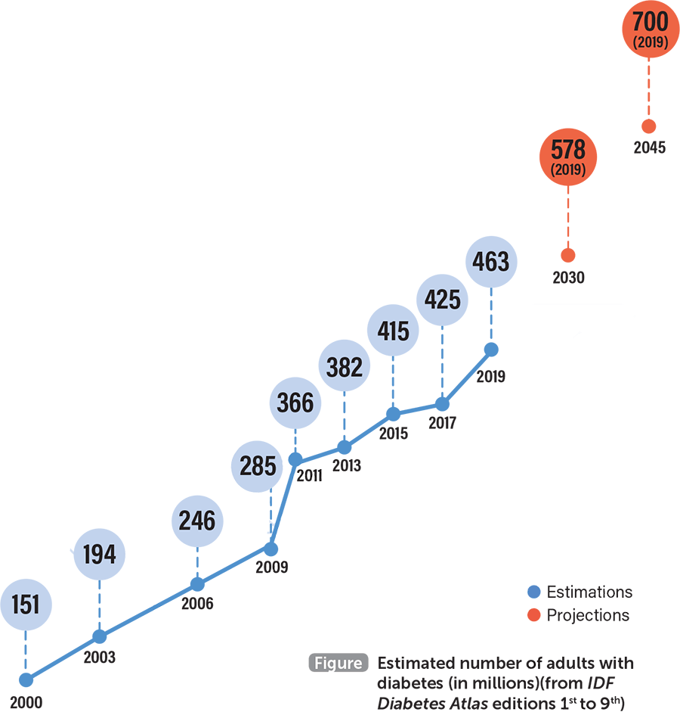
Introduction
Diabetes is one of the most common and preventable diseases.
422 million people in 2015
Adults with diabetes have a two- to three-fold increased risk of heart attacks, strokes and leading causes of kidney failure.
Types of diabetes:
Type 1
Type 2
Prediabetes
Gestational diabetes
Dataset to predict diabetes based on glucose levels, BMI, BP, skin thickness, insulin in females.

Slide 4
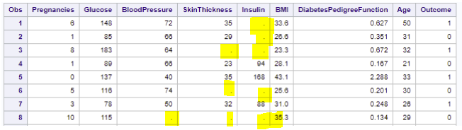
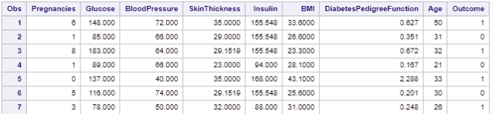
Data preprocessing - Null/missing values handling
Step 1 >>>
Step 2 >>>

Slide 5
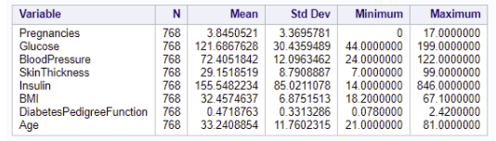
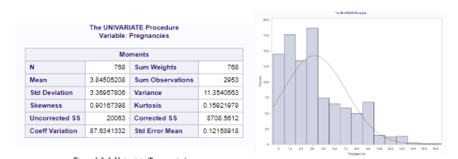
Descriptive Analysis
Means values >>>
Univariate values >
To determine what variables are to be transformed

Slide 6
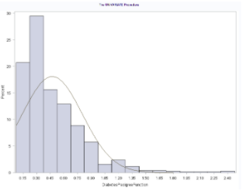
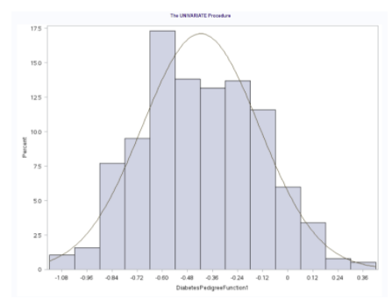
Data transformation
>>>
Variables which are not normal being transformed to normal.

Slide 7
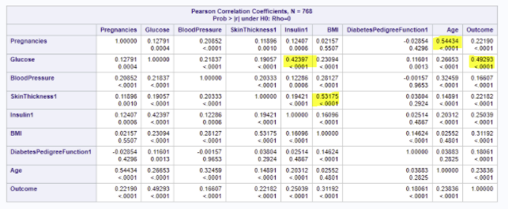
Correlation Analysis
Finding the right correlation between variables which impact the dependent variable.

Slide 8
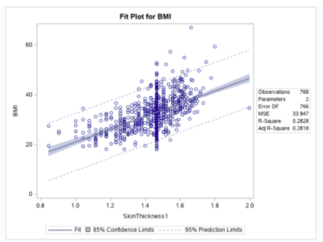
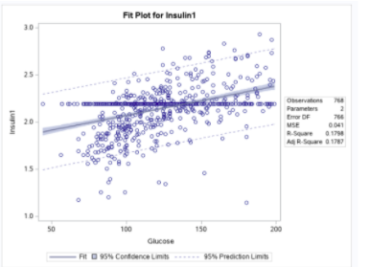
Regression Analysis
BMI vs Skin thickness regression Insulin vs Glucose regression

Slide 9
Conclusion
Regression is a good tool to predict values when it comes to simple datasets. Everytime, machine learning is not required to accomplish a task. The capability to predict diabetes early, assumes a vital role for the patient's appropriate treatment procedure. The results have shown that there is a strong association of BMI and glucose with diabetes.
Now, coming back to our business question. We can firmly say that the Hypothesis is true as we accept H0, we can reject H1. Glucose is a better predictor of diabetes than the other variables in the dataset.
Please refer to doc file for detailed analysis

